Slide 1
Battle of the Neighborhoods
Manhattan vs. Toronto

Slide 2
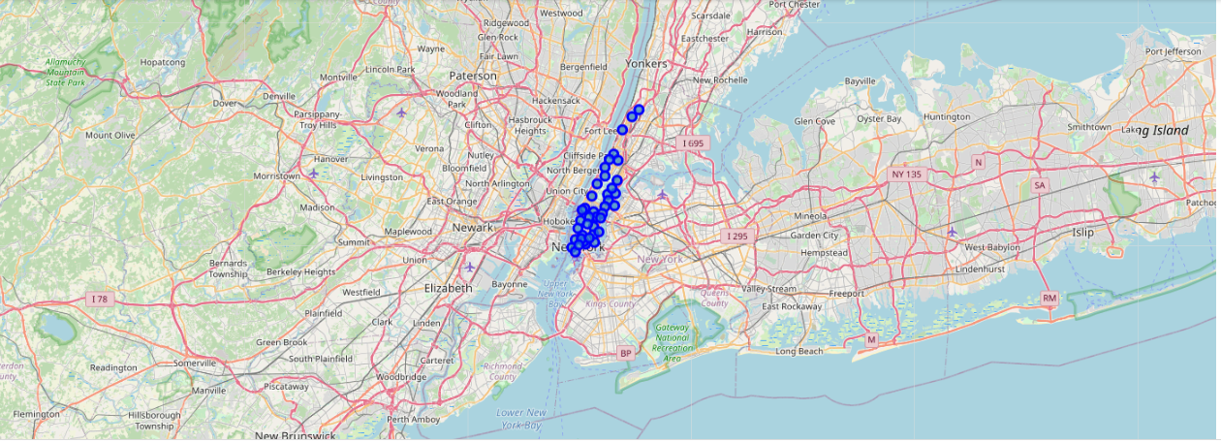
Manhattan Map

Slide 3
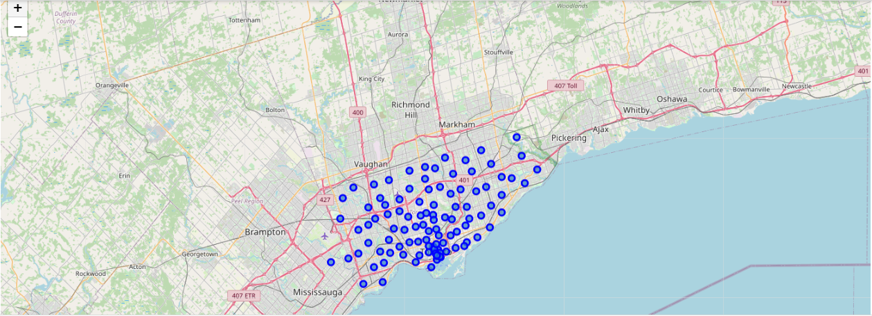
Toronto Map

Slide 4
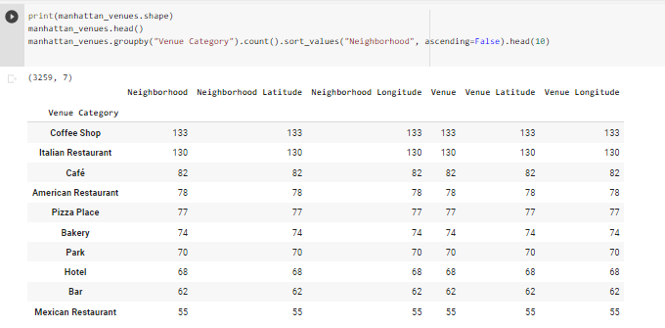
What is the most common Venue Category in Manhattan

Slide 5
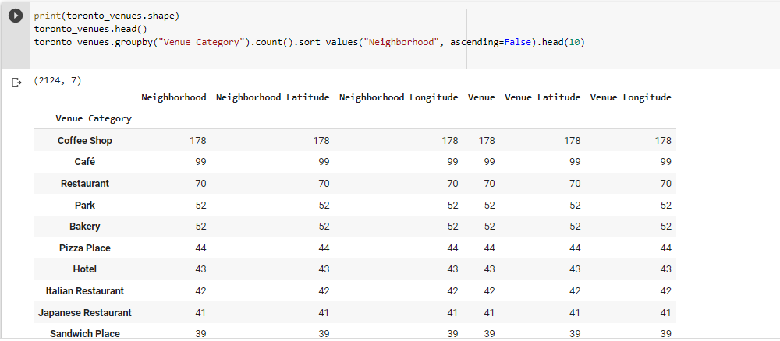
What is the most common Venue Category in Toronto

Slide 6
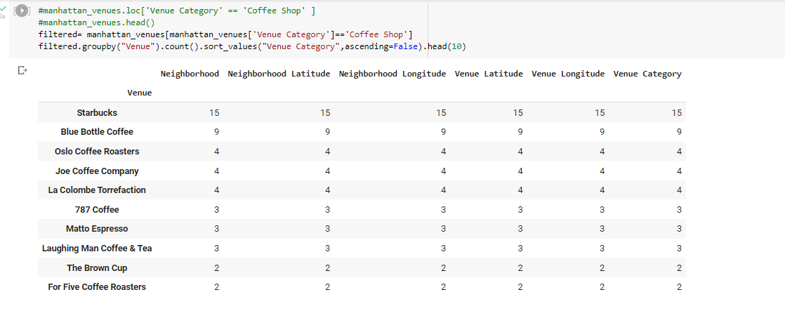
What is the most common venue in Manhattan?

Slide 7
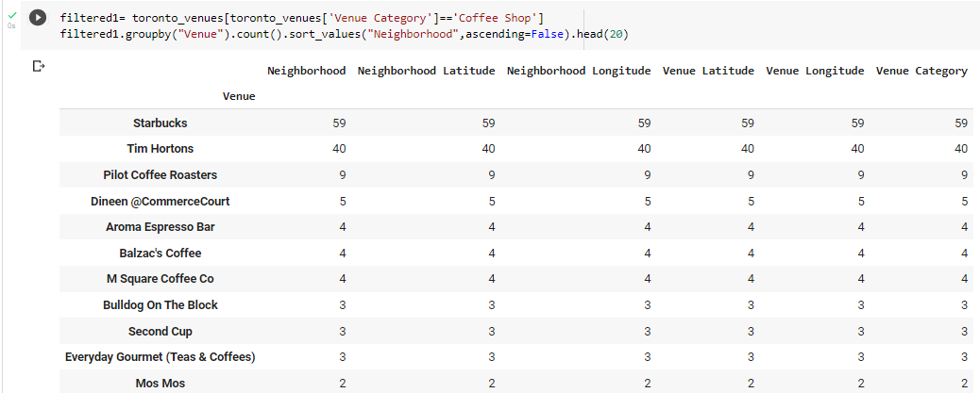
What is the most common venue in Toronto?

